Slide 1
Space Man In 2D In Space

Slide 2
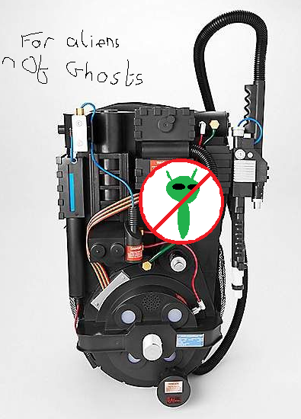
Elevator Pitch
One astronaut must risk his life protecting the earth by capturing the villainous aliens and allow the helpless refugees to seek refuge on earth.
In a 2D Plain of space as the attackers float and fly toward you wrangle the up with your High-Tec defensive device.

Slide 3
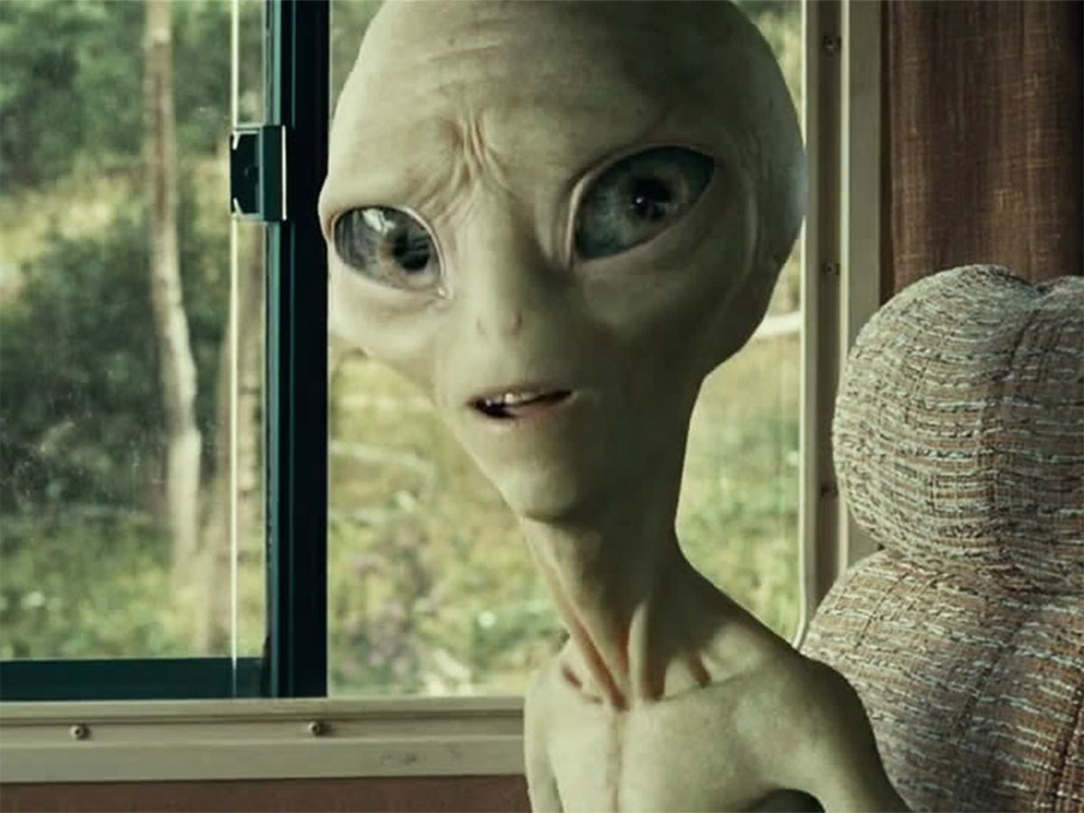
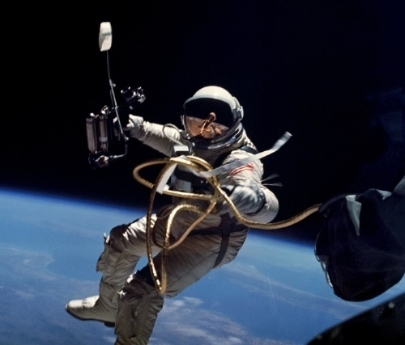
Gameplay Description:
Move side to side guarding the earth by not allowing evil aliens through.
But at the same time allowing other fleeing astronaut by to safety.

Slide 4
Pillars:
Saving the world
Phenomenal Soundtrack
Challenges The Player
Exciting Visuals

